Slide 1

Name: Karan Singh
Narmin Chandiwala
College: Mulund College of Commerce Department of Computer Science

Slide 2

Federated Learning for Cybersecurity: Detecting Malware
Revolutionizing malware detection through decentralized collaboration.
Protecting sensitive data while improving threat intelligence.
Statistics: 40% increase in detection accuracy reported in recent studies.

Slide 3

The Cybersecurity Challenge: A Data Problem
Traditional Centralized Approaches
Single point of failure risks disrupting detection systems.
Data Silos
Limit the scope and effectiveness of threat models.
Privacy Concerns
Hinder data sharing and collaboration across organizations.
Statistic
68% of organizations face challenges in sharing threat data.

Slide 4
What is Federated Learning?
Decentralized Learning
Privacy Preserving
Model Aggregation
Statistic
Data remains on local devices, ensuring confidentiality.
Combines insights from distributed data sources efficiently.
90% reduction in data transfer versus centralized learning.
Training models across multiple devices locally.

Slide 5
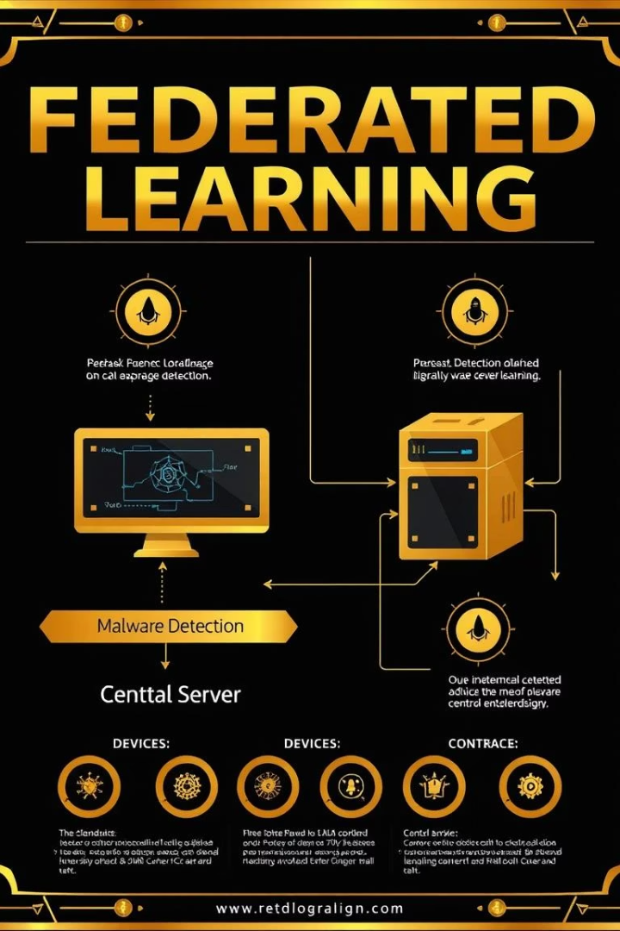




Federated Learning in Malware Detection: How It Works
Local Training
Each device trains a malware detection model on its own data.
Model Aggregation
A central server combines models from multiple devices.
Improved Accuracy
Detects a wider range of malware threats effectively.
Real-Life Example
Intel detects zero-day exploits 3x faster using federated learning.

Slide 6





Technical Deep Dive: How It Works
Data Preprocessing
Feature extraction on client devices locally.
Local Model Training
Training decentralized models on client data.
Secure Aggregation
Server combines model updates without data exposure.
Global Model Update
Refined model sent back to clients continuously.

Slide 7
Current Usage Across Industries
Antivirus Companies
Healthcare
Mobile Security
Corporate Networks
Avast and McAfee improve detection without data sharing.
Hospitals detect threats while complying with HIPAA.
Google enhances Android malware detection on devices.
Collaborative anomaly detection without central logs.
Cloud Platforms
Microsoft Azure shares threat intelligence securely.

Slide 8

Real-World Example 1: Mobile Malware Detection
Google's Approach
Privacy Focus
Uses federated learning on Android to detect malicious apps.
Identifies threats without compromising user data privacy.
Statistic
20% improvement in detecting previously unseen malware samples.

Slide 9
Real-World Example 2: Financial Fraud Detection
Bank Collaboration
Privacy Preservation
Statistic
Share fraud detection insights without exposing customer data.
Federated models protect sensitive financial information.
35% reduction in false positives using federated learning.

Slide 10

Benefits of Federated Learning in Cybersecurity
Enhanced Privacy
Improved Accuracy
Data never leaves local devices, increasing confidentiality.
Training on varied datasets boosts detection capabilities.
Reduced Latency
Statistic
Faster threat detection across distributed networks.
50% faster malware detection in federated network setups.

Slide 11

Challenges and Future Directions
Communication Costs
Optimizing data transfer and aggregation overhead.
Security Risks
Model poisoning attacks can reduce accuracy by 60%.
Future Trends
Homomorphic encryption enhancing federated model security.

Slide 12

Conclusion: Federated Learning - A Paradigm Shift
40%
290%
$265M
Detection accuracy increase from studies
Projected CAGR for federated learning market by 2025
Estimated market size by 2025
Enables collaboration protecting sensitive data.
Adopted by Google, Intel, and leading banks globally.

